Slide 1
Coffee Consumption
and Tech Use at Starbucks
By Shirley Lei and Brett Moody

Slide 2
Background
Customers who spend the longest time at coffee shops tend to be those using tech. They tend to stay without buying additional drinks, meaning the profit returns on offering them space are low.

Slide 3
Our Question
Is There a Relationship Between a Customer’s Tech Usage and Their Apparent Coffee Consumption?

Slide 4
Our Hypothesis
As Customers Use More Advanced Tech (Computer > Smartphone > Nothing), They Will Buy Larger Quantities of Coffee to Last Them Throughout that Time.

Slide 5
Coded Variables
Tech Count
0 = No Starbucks Drink
1 = Small Coffee
2 = Medium Coffee
Drink Size
-1 = Drinking a Competitor’s Drink
0 = No Starbucks Drink
1 = Small Coffee
2 = Medium Coffee
3 = Large Coffee

Slide 6
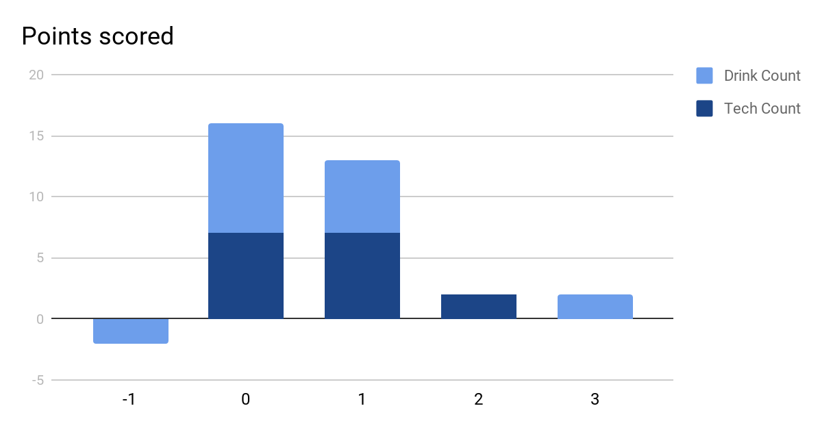
There is no “-1” or “3” value for the ‘Tech Count’ Variable.

Slide 7
~0.6789
Positive Correlation

Slide 8
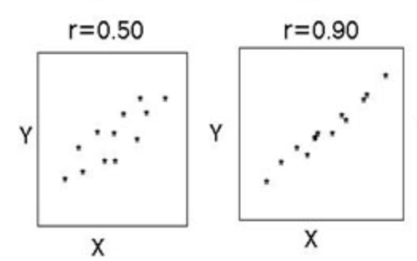
Conclusion
As tech use increases, drink size increases. This correlation is strong but not perfect. This finding could mean that contrary to belief, customers who stay longer do provide the coffee shop fair compensation for their prolonged stay.
If we were to graph our correlation of 0.68, it would look something like between these two graphs.

Slide 9
Thank You!

